Slide 1
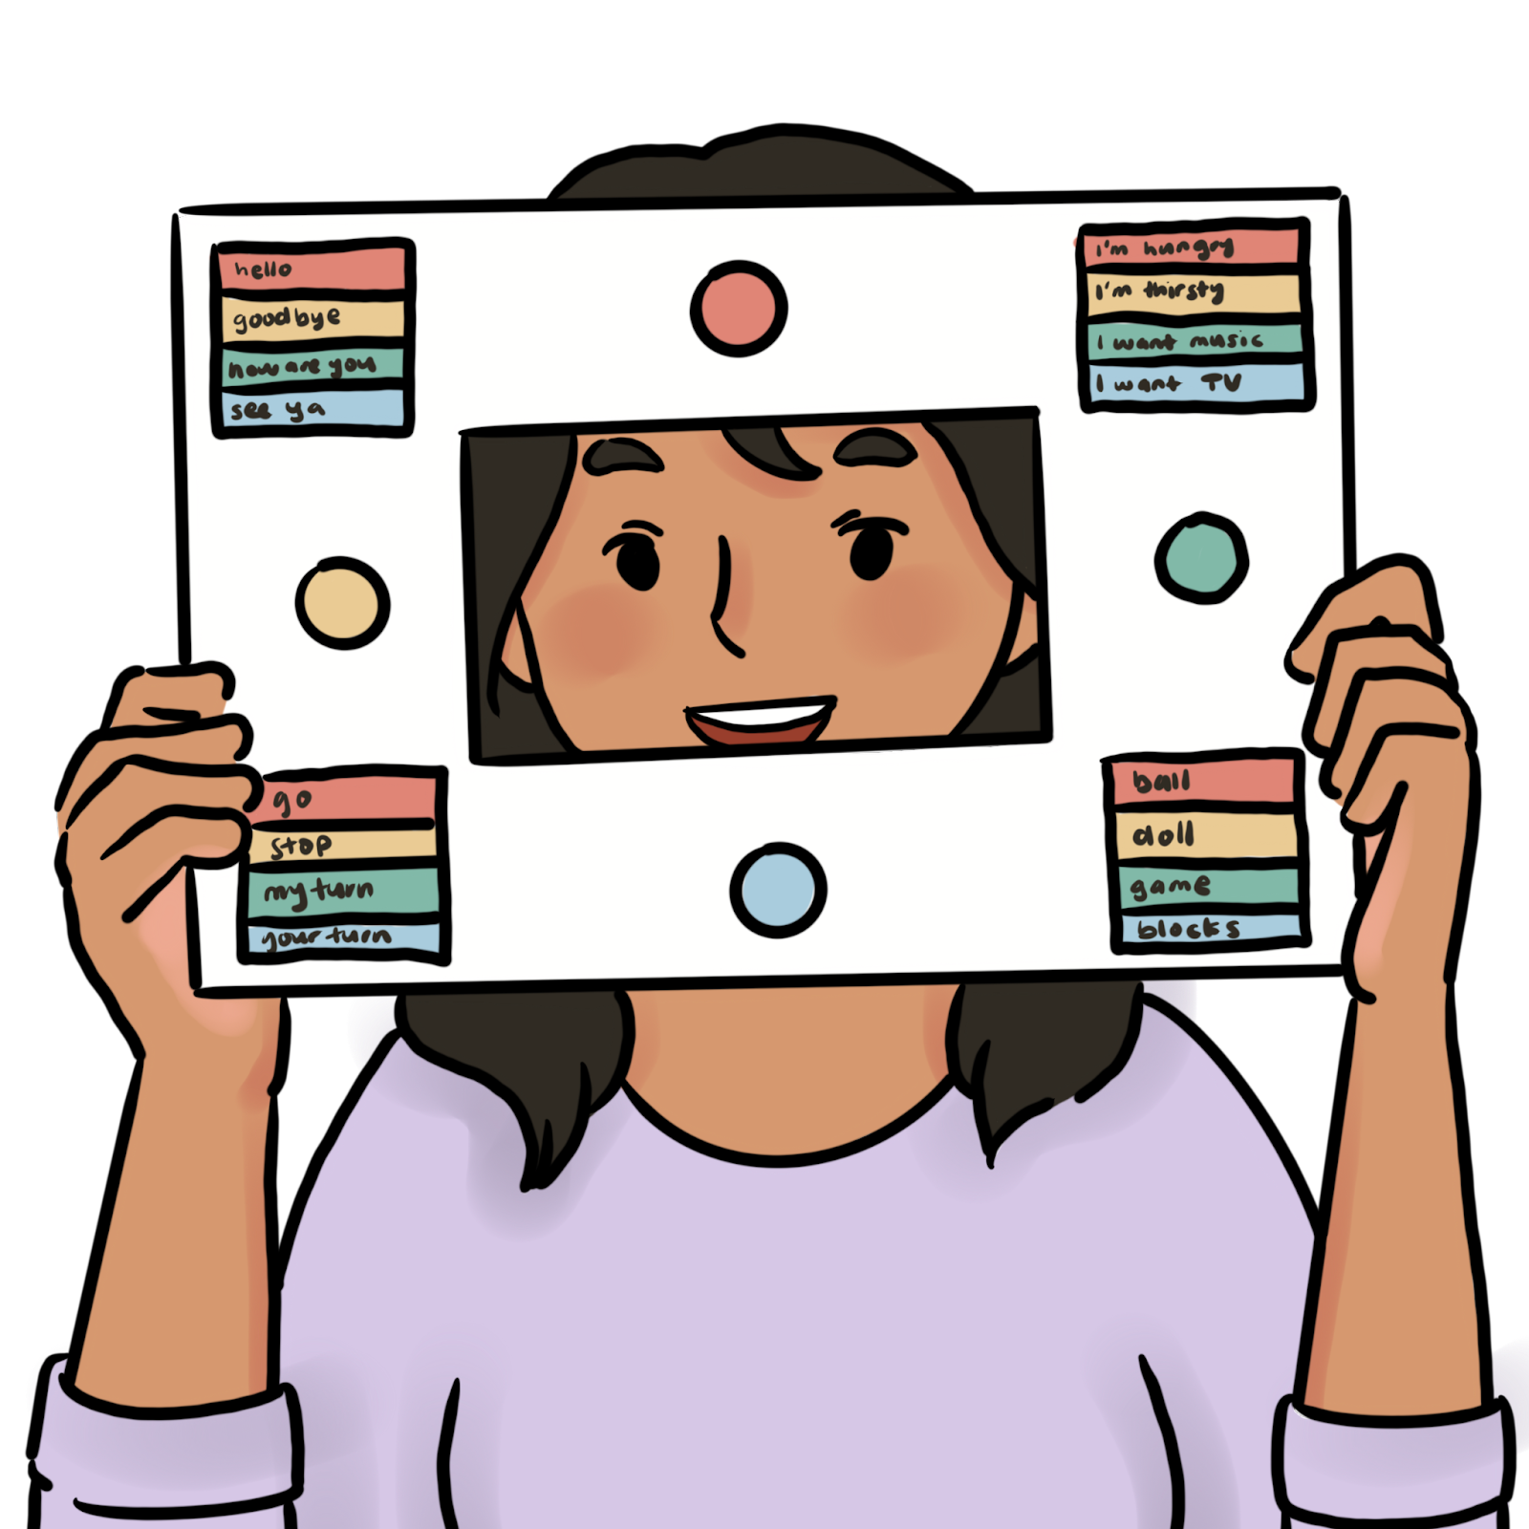
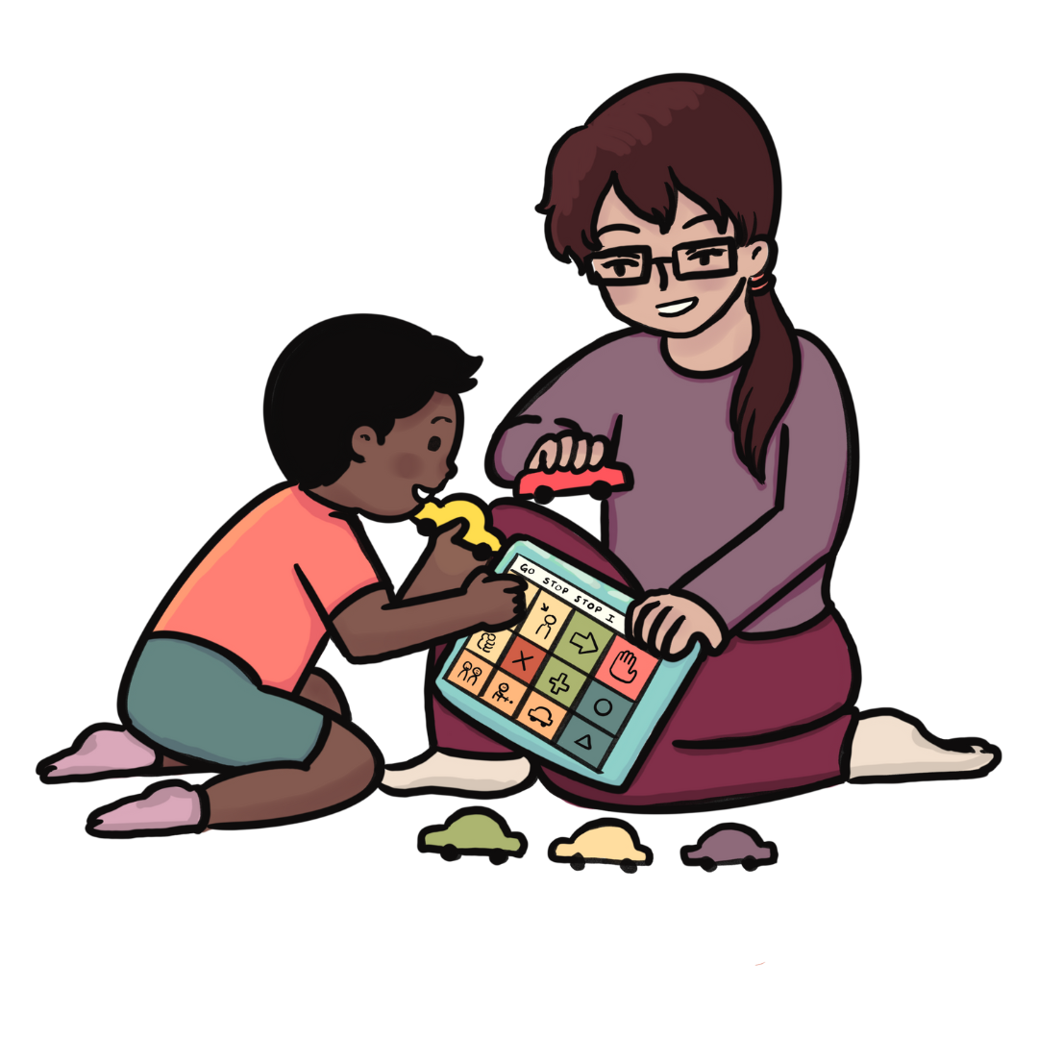
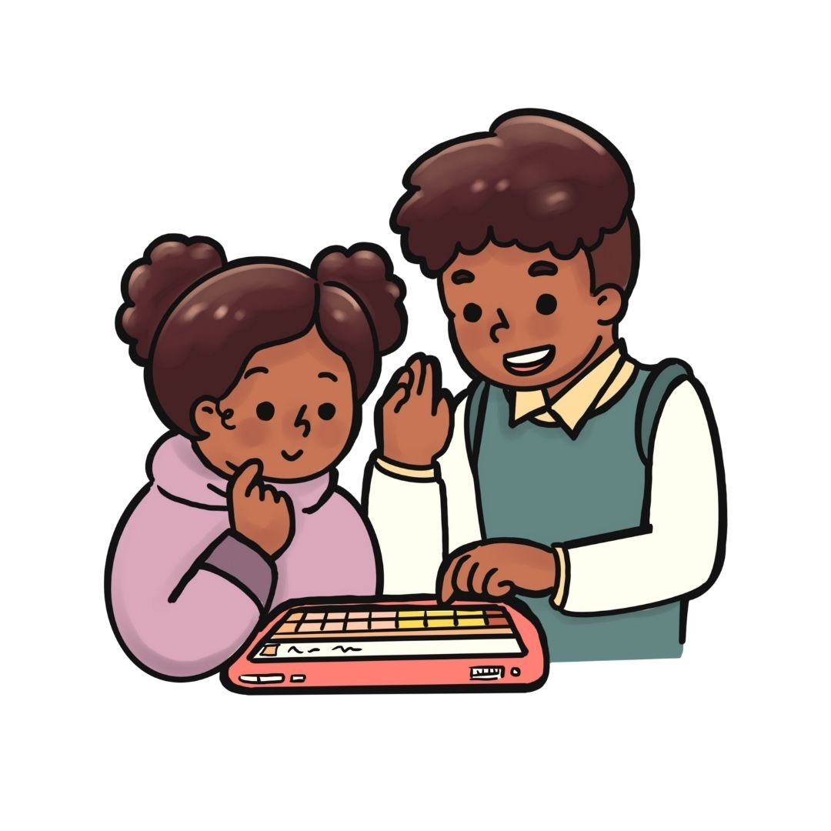
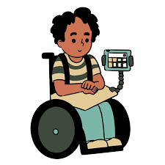

5 Quick Tips to Grow AAC Communication

Slide 2

1. Model
Modelling is using AAC books, boards, buttons, switches and device to speak AAC
Model some main words or ideas to help AAC users learn how they can use their books, boards, buttons, switches and device
Modelling builds language learning for all, not just AAC users

Slide 3
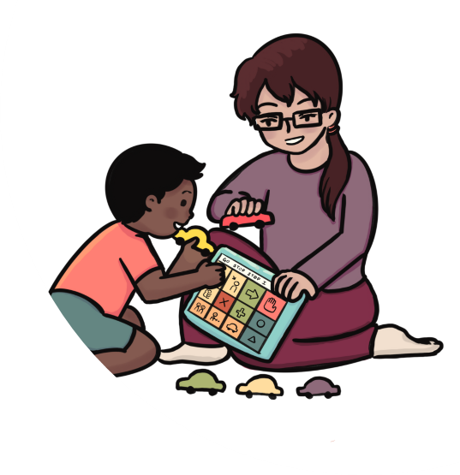
2. Expand
Expand on words a communicator shares to build on the message
Ass a descriptive work or a clarifying term to help develop their language skills
For example; the young person says “bus” and you can say “yes that’s a yellow bus”

Slide 4
3. Comment
Questions can help you engage someone but often commenting allows more neural interaction with less pressure or demand.
For example; “it seems you like animals, may favourite animal is…”

Slide 5
4. Pause and Wait
Give them plenty of time to make their response!
Patient, expectant and pause helps show you care what they have to say.
Wait… and then wait a bit more!
Keep in mind that no response is also acceptable!

Slide 6
5. Believe
You and your communicator must believe in each other to succeed.
Have high but realistic expectations of the interaction you have.
When you work with an attitude of trust and confidence and incredible things WILL happen!

